Slide 1

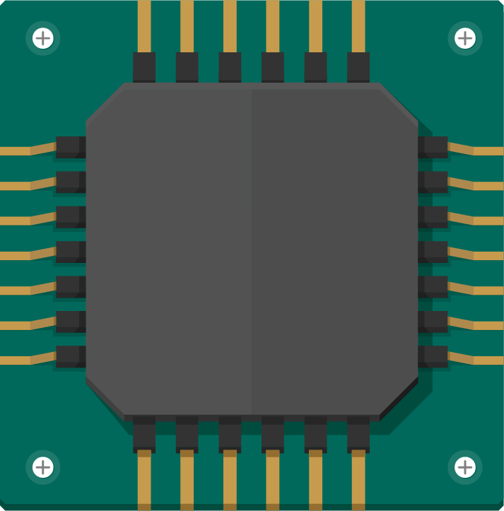
Group 12
Osei-Adu Jesse
Adusei Gregory
Nana Kwame Anyanful
Brian Akosah
Quartey Boye Mensah Richmond
Boatemaa Akosua Osei
Klenam Delvin Koku Hottor
Alifo Delali Kelvin
Addae Samuel Nyarko
Kelvin Agbozo

Slide 2
Table of contents
01
02
03
04
Problem Statement
Methodology
Demonstration
Conclusion

Slide 3
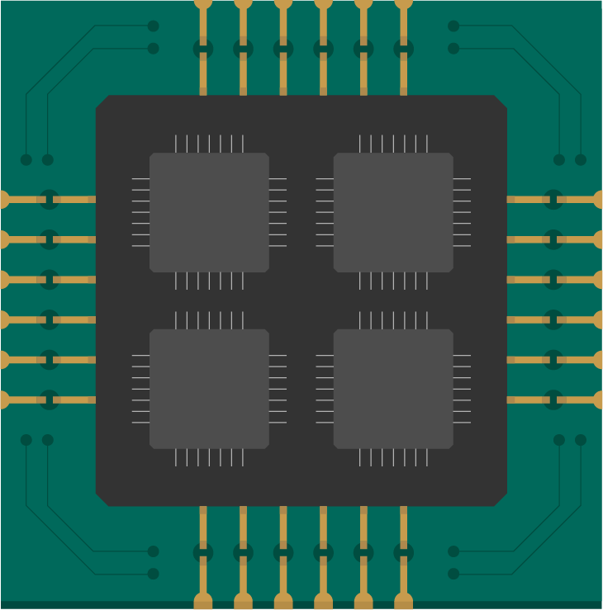
01
Problem Statement

Slide 4
Smart Traffic Light System – Adjusts signals based on real-time traffic density.
The problem statement required us to build a smart density-based traffic control system.
The system is expected to adjust lane signals based on real-time traffic density.
If a lane becomes busier than the others, the system is supposed to permit the cars in that lane to move.

Slide 5
02
Methodology

Slide 6
Proteus 8 was used for the simulation since it contained more components and functionalities as compared to the online simulators.
A Genuino Uno microcontroller was used since it supported the connection scheme.
In order to produce a schematic diagram devoid of wires stretching across it, input and output pins(mapped together by labels) were used.
The input pins were connected to the traffic lights and IR sensors.
The output pins were connected to the microcontroller.

Slide 7
The schematic diagram composes of a four-way intersection with four traffic lights at strategic positions(lanes).
Each lane is also assigned an IR sensor to drive the density-based traffic control.
Real-world input to the sensors were simulated as logic toggles connected to the “TestPin” pins of the IR sensor.
A toggle “1” implies a lane is busy and “0” implies a lane is less busy.

Slide 8
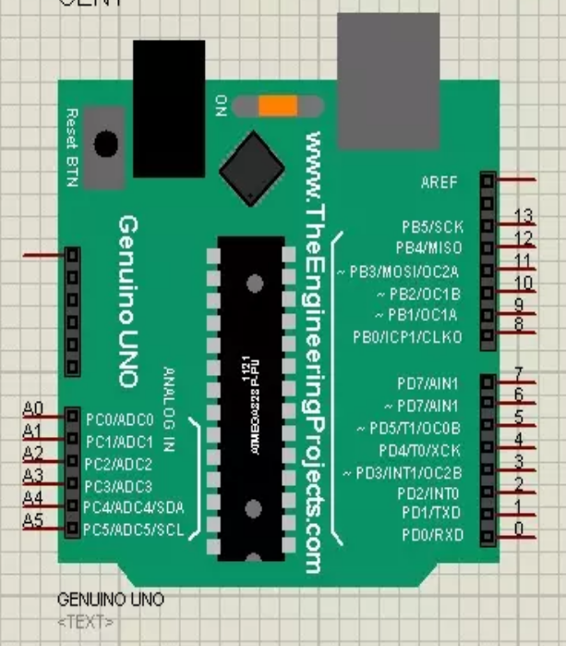
Components Used
Genuino Uno board
Only the digital and analog input pins are used.

Slide 9
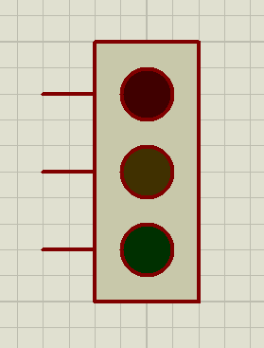
Components Used
Traffic Light
Each pin goes a digital input pin on the microcontroller

Slide 10
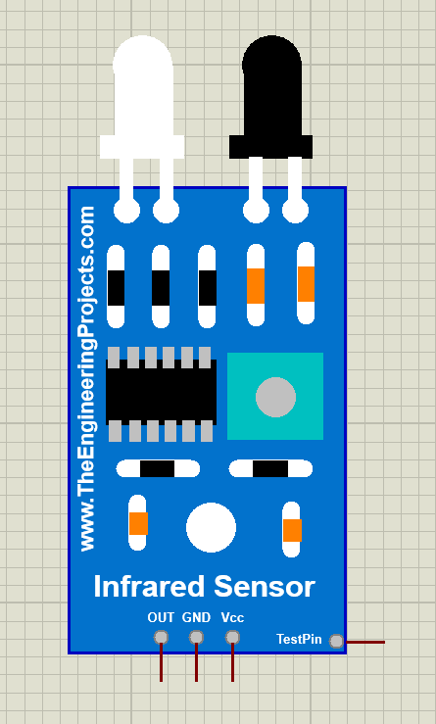
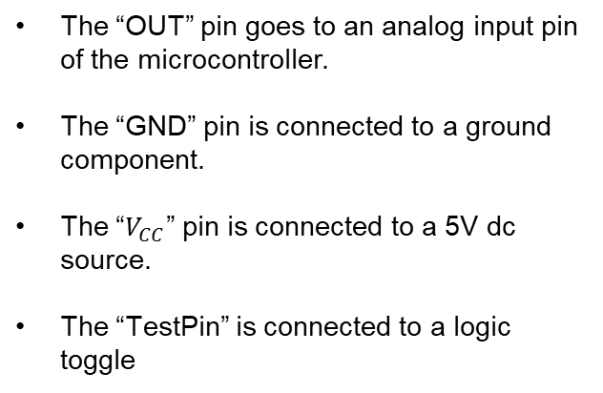
Components Used
IR Obstacle Sensor
The “OUT” pin goes to an analog input pin of the microcontroller.
The “GND” pin is connected to a ground component.
The “$V_{CC}$” pin is connected to a 5V dc source.
The “TestPin” is connected to a logic toggle

Slide 11
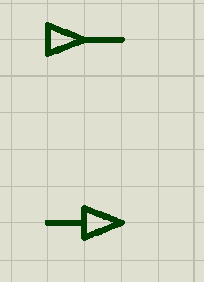
Components Used
(Top to Bottom)
Input and Output pins
Used to join components to the microcontroller.
Eliminates the need for wires from the micontroller pins to the component pins.
This gives a clean schematic diagram.

Slide 12
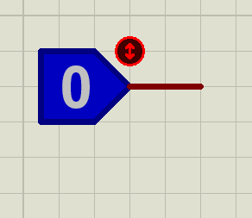
Components Used
Logic Toggle
Used to simulate a lane becoming busy.
A “1” implies a lane is busy.
A “0” implies a lane is less-busy.

Slide 13
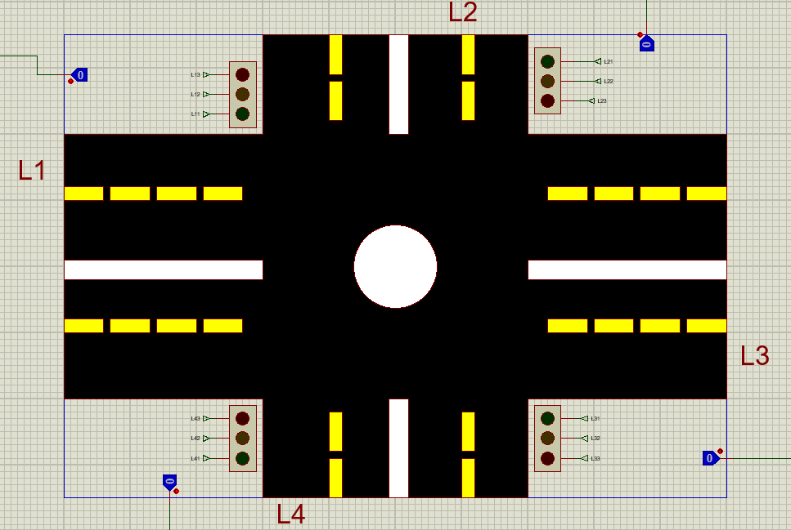
Components Used
Four-way Intersection
Used to simulate a real-life four-way intersection.

Slide 14
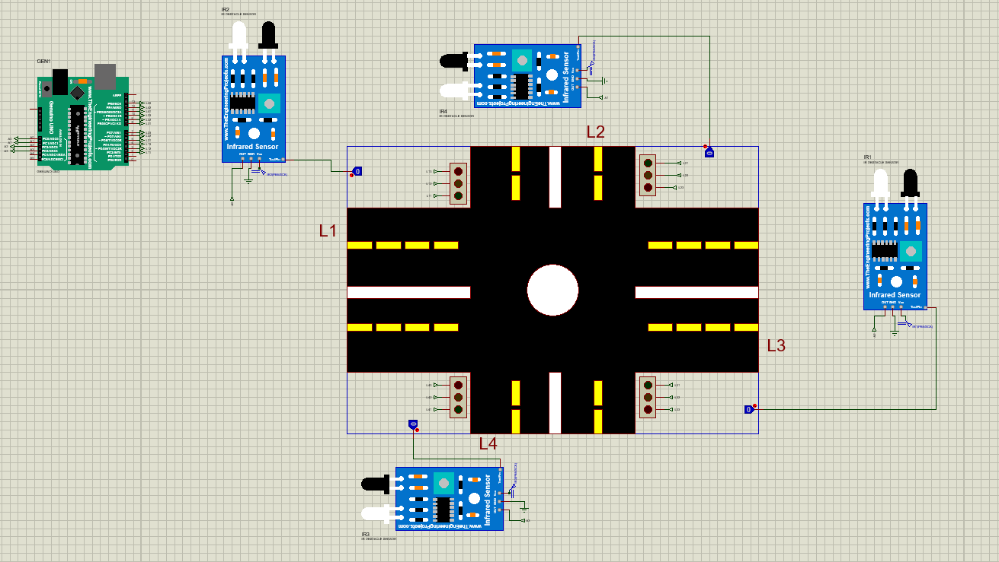
Schematic Diagram

Slide 15
03
Demonstration

Slide 16
Initial Timed Sequence
Under normal operations, the traffic light system follows an 8-step timed sequence:
Cycle 1: Lane 1 Green, Lane 2 Red, Lane 3 Red, Lane 4 Red
Cycle 2: Lane 1 Green and Yellow, Lane 2 Red and Yellow, Lane 3 Red, Lane 4 Red
Cycle 3: Lane 1 Red, Lane 2 Green, Lane 3 Red, Lane 4 Red
Cycle 4: Lane 1 Red, Lane 2 Green and Yellow, Lane 3 Red and Yellow, Lane 4 Red
Cycle 5: Lane 1 Red, Lane 2 Red, Lane 3 Green, Lane 4 Red
Cycle 6: Lane 1 Red, Lane 2 Red, Lane 3 Green and Yellow, Lane 4 Red and Yellow
Cycle 7: Lane 1 Red, Lane 2 Red, Lane 3 Red, Lane 4 Green
Cycle 8: Lane 1 Red and Yellow, Lane 2 Red, Lane 3 Red, Lane 4 Green and Yellow

Slide 17
Initialization Start-Up and Priority Override
During an initialization start-up, that is, when the simulation starts with a lane being busy, its green light is turned on and all other lanes will have a red light.
The busy lane remains green until it becomes less-busy.
When a busy lane becomes less-busy, it turns red and if another lane becomes busy, that lane turns green.
When no other lane is busy, the system proceeds with the timed sequence from the previously busy lane.

Slide 18
Toggle Conflicts
When multiple toggles are ON (high density), the system decides lane priority using a fair, deterministic policy.
Options include:
- Fixed Priority: Lane 1 > Lane 2 > Lane 3 > Lane 4.
- Round-Robin: Cycle through lanes with high density in a fixed order.
- First-Come-First-Served: The first toggle turned ON gets priority.
A priority-based approach was implemented, following the fixed priority order: Lane 1 has the highest priority. Followed by Lane 2, then Lane 3, and finally Lane 4.

Slide 19
References and Resources
Circuit concept and inspiration: Arduino Smart Traffic Light in Proteus 8 with the Help of Chat GPT for Automated Code Generation
Density based traffic light control system | Arduino Project Hub
Proteus Arduino libraries: New Proteus Libraries for Engineering Students - The Engineering Projects

Slide 20
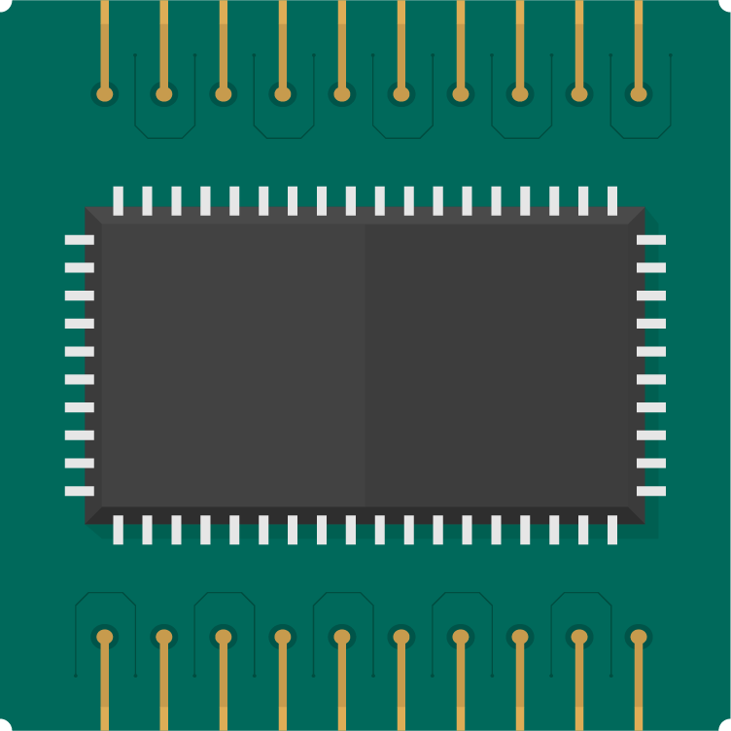
Thanks!
Do you have any questions?
Please keep this slide for attribution

